Slide 1
LIFT MANAGEMENT SYSTEM IN VIETNAM
MANAGEMENT SYSTEM ON LIFT SAFETY IN VIETNAM
Mr. Chu Van Cong
(+84).916 823616
International Lift Expo Korea 2021
congcv@molisa.gov.vn
Ha Noi, Viet Nam

Slide 2
CURRENT
Status
LIFT MANAGEMENT SYSTEM IN VIETNAM
Law on standards and technical regulations in 2006
Law on product and goods quality in 2007
The OSH Law in 2015
LAW
DECREE
Decree No. 127/2007/ND-CP
Detailing a number of articles of the Law on Standards and Technical Regulations
Decree No. 39/2016/ND-CP
Detailing the implementation of a number of articles of the Law on occupational safety and health
Decree No. 78/2018/ND-CP
Amending and supplementing a number of articles of the Government's Decree No. 127/2007 / ND-CP
Circular issued
National technical regulation
QCVN 02: 2011/BLĐTBXH
QCVN 18: 2013/BLĐTBXH
QCVN 26: 2016/BLĐTBXH
QCVN 32: 2018/BLĐTBXH
QCVN 02: 2019/BLĐTBXH
CIRCULARS
DECISION, DIRECTIVE

Slide 3
CURRENT
Status
Installed and used in Viet Nam
300.000 Total
On the market
8000 Pcs/Year

Slide 4
CURRENT
Status
Advantages
With the speed of urbanization, high-rise buildings sprout up rapidly
Elevator market in Vietnam is currently one of the potential markets
Dis-Advantages
Investment in facilities for certification and testing activities is still limited
Database on the elevator has not been interested in building, the data is only based on data reported from the organization through hard documents.
Users are still not interested in the maintenance and routine maintenance of elevators

Slide 5
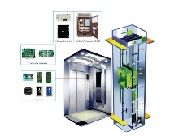
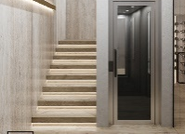
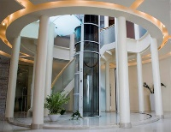
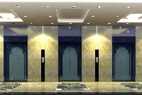
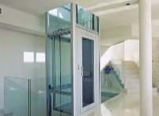
2011
2016
QCVN 02
QCVN 26
National technical regulation on safe work for electric lift
National technical regulation on safe work for machine room-less electric lift
2013
QCVN 18
2019
National technical regulation on safe work for Hydraulic lift
QCVN 02
National technical regulation on safe work for lift
2018
QCVN 32
National technical regulation on safe work for home lift
TECCHNICAL REGULATION

Slide 6
NATIONAL TECCHNICAL
REGULATION ON SAFETY
FOR LIFT
TCVN 6396-20:2017
QCVN 02: 2019/BLĐTBXH
EN 81-20:2014 Safety requirements on elevator construction and installation - Elevators for transporting people and goods - Part 20: Passenger elevators and elevators carrying people and goods
TCVN 6396-50:2017
EN 81-50:2014 Safety requirements on structure and lift installation - Testing and testing - Part 50: Requirements on design, calculation, inspection and testing Test elevator parts

Slide 7
NATIONAL TECCHNICAL
REGULATION ON SAFETY
FOR LIFT
NATIONAL
TECCHNICAL REGULATION
ON SAFETY FOR LIFT
1. General rules
1.1 Scope of application
1.2 Subjects of application
1.3 Terminology and definitions
2. Technical regulations
3. Regulations on quality management
4. Responsibilities of organizations and individuals
5. Implementation organization
Scope of application

Slide 8
NATIONAL TECCHNICAL
REGULATION ON SAFETY
FOR LIFT
Applies:
Machine room or machine room-less
Hydraulic
Does not apply:
Home elevators are regulated in QCVN 32:2018/BLDTBXH Regulations
Have a rated speed ≤ 0.15 m/s
Hydraulic ladder with rated speed exceeding 1 m/s
Hydraulic elevators with rated speed exceeding 1 m/s or hydraulic elevators if the pressure relief valve is set to exceed 50 MPa
Lifting devices, reels, mine lifts, stage lifts, automatic bucket lifts, lifts, lifts and hoists for construction sites of public buildings and buildings, winches on ships, offshore exploration or drilling rigs, construction and maintenance equipment or lifts in wind turbines
Other provision:
For elevators installed in existing buildings, EN 81-21 can be applied
In addition to meeting the requirements of this Regulation, elevators must meet additional requirements according to specialized laws in special cases.
NATIONAL TECCHNICAL
REGULATION ON SAFETY
FOR LIFT
Scope of application
Technical regulations

Slide 9
1. General
2. Well, machinery spaces and pulley rooms
3. Landing doors and car doors
4. Car, counterweight and balancing weight
5. Suspension means, compensation means and related protection means
6. Precautions against free fall, excessive speed, unintended car movement and creeping of the car
7. Guide rails
8. Buffers
9. Lift machinery and associated equipment
10. Electric installations and appliances
11. Protection against electric faults; failure analysis; electric safety devices
12. Controls - Final limit switches - Priorities
NATIONAL TECCHNICAL
REGULATION ON SAFETY
FOR LIFT
Technical regulations

Slide 10
INSPECTION
COMFORMITY
Management regulations
MAINTENANCE
USING

Slide 11
CERTIFICATION BODY
Appointed by Molisa
Facilities for certification activities
At least 04 Auditors
COMFORMITY ACTIVITY
Domestic production
Conformity announcement
Import production
Check the quality when importing
Certification method
Method 5, method 7 or method 8 promulgated together with Circular No. 28/2012/TT-BKHCN & Circular No. 02/2017/TT-BKHCN

Slide 12
CERTIFICATION BODY
Appointed by Molisa
Facilities for certification activities
At least 04 Auditors
Number of certification bodies:
20

Slide 13
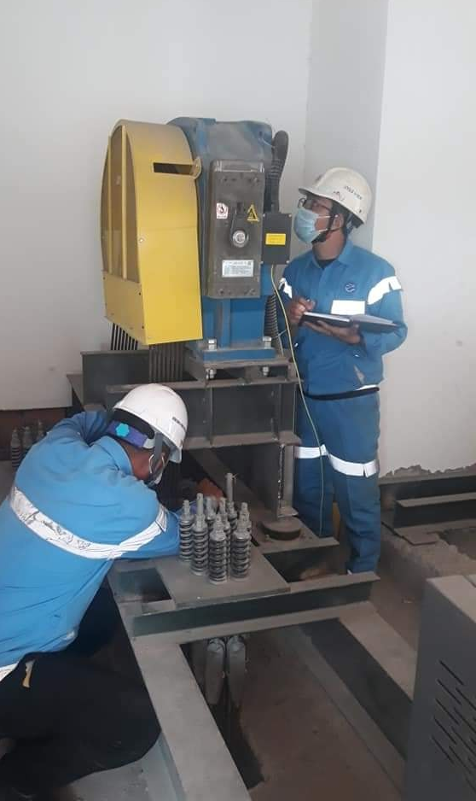
TECHNICAL SAFETY INSPECTION
Technical inspection of elevator safety is carried out according to the inspection process issued by the Ministry of Labor
FIRST TIME
PERIODIC
ABNORMAL
inspection before put into use for the first time.
inspection the expiration of the previous accreditation visit
inspection when: Repair, upgrade, renovate; Upon request of the competent authorities

Slide 14
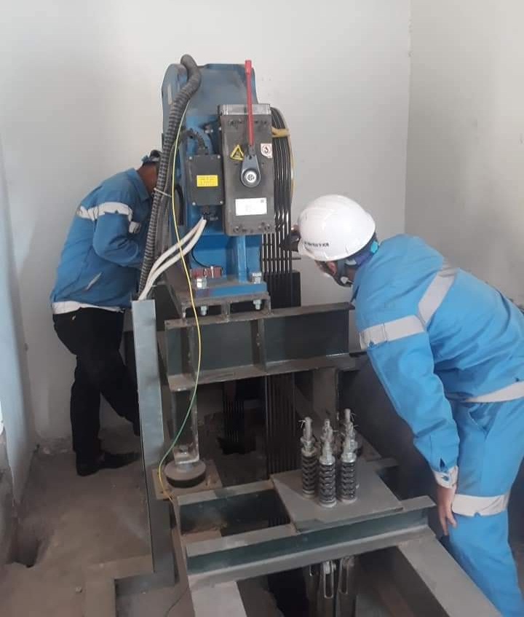
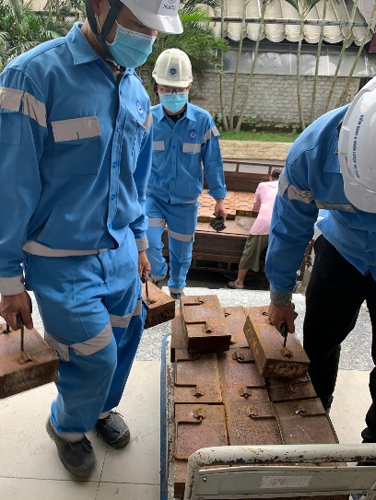
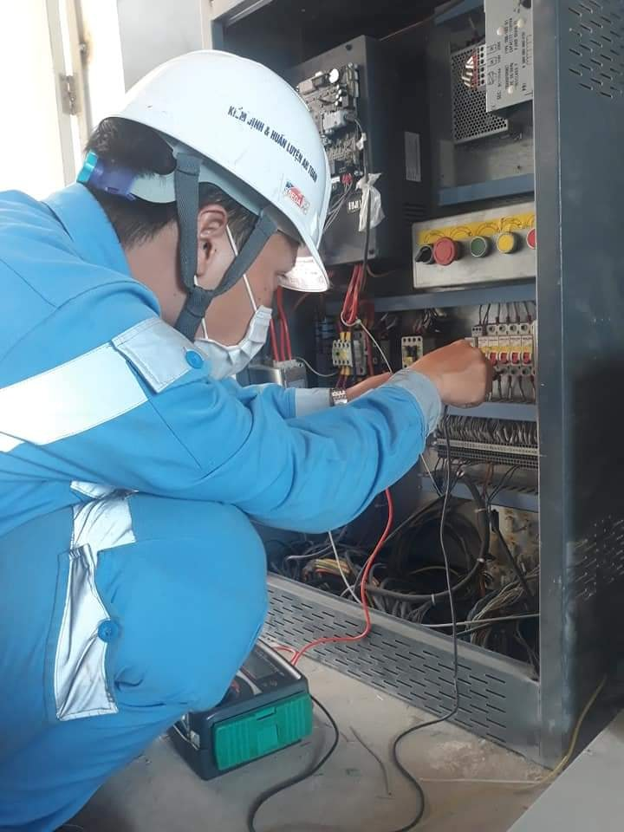
INSPECTION BODY
Appointed by MOLISA
Facilities
At least 02 inspectors
68

Slide 15
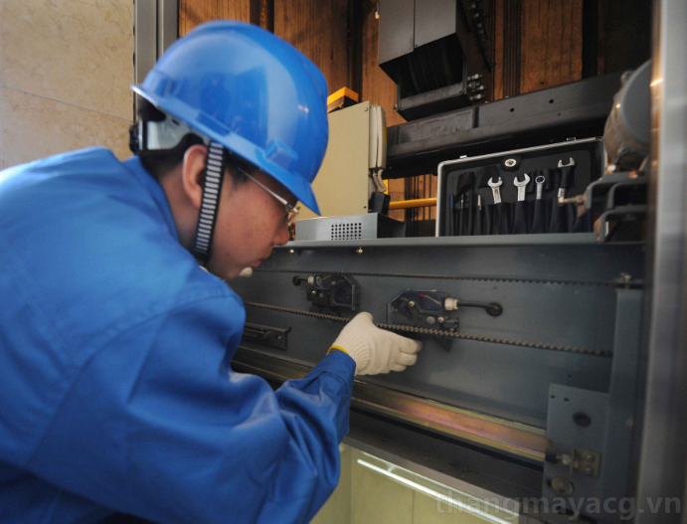
MAINTENANCE
03 month
Under normal conditions
01 month
Elevators are installed in apartments, office buildings, commercial center buildings, hospitals, hotels, manufacturing plants, public areas

Slide 16
USER RESPONSIBILITIES
Technical inspection before put into use
Keeping the records and documents relating to lifts
Arrange at least 01 person to be responsible for elevator operation
Declare the use of the elevator with the local Labor Office

Slide 17
VISION
& MISSION
Building elevator management database
Improving the quality of elevator inspection, testing and inspection activities
Strengthening international cooperation, learning management experience from developed countries

Slide 18
THANK YOU
FOR YOUR ATTENTION!

